Slide 1
Sjögren’s Syndrome
Mohammad Shooriabi. Assistant Professor, Department of Oral Medicine, Faculty of Dentistry, Ahvaz Jundishapur University of Medical Sciences, Ahvaz, Iran

Slide 2
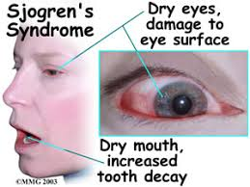
Introduction
Chronic autoimmune disease
  oral and ocular dryness
  lymphocytic infiltration
  destruction of exocrine glands
Dryness may affect other mucosal areas

Slide 3
Continue
Signs of systemic autoimmune disease with musculoskeletal, pulmonary, gastric, hematologic, dermatologic, renal, and neurologic manifestations many also be evident in patients with SS
frequently experience fatigue, arthralgias, myalgias, peripheral neuropathies, and rashes

Slide 4
Etiology of SS
35% of patients with SS have relatives with other autoimmune diseases
In patients with SS, the prevalence and titres of antibodies against EBV early antigens were significantly higher than in a control group.
In addition, a lower prevalence and titres of rubella and CMV antibodies (IgM) were detected in patients with SS

Slide 5

Classification
Affects perimenopausal and postmenopausal women
SS is classified as
  Primary
    0.2%–3.0% of the population with a female-to-male ratio of 9:1.
  Secondary

Slide 6
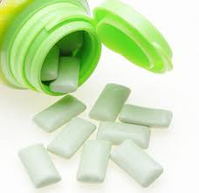
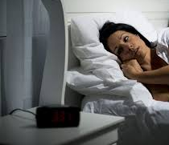
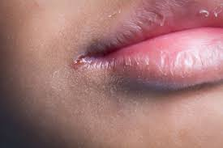
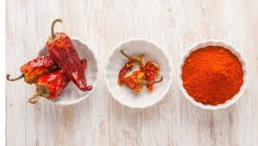
Clinical Manifestations
Xerostomia may first become evident with nocturnal awakening with thirst
The need to have chewing gum or lozenges to stimulate saliva production.
Sensitive to spices and heat.
Patients often have dry, cracked lips and angular cheilitis.

Slide 7
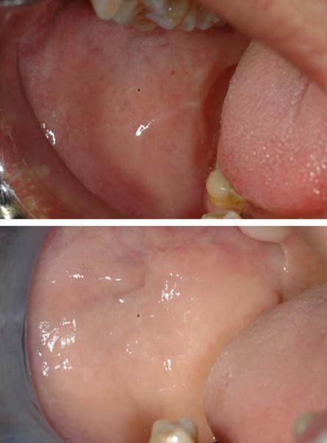
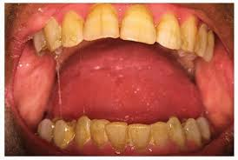
Continue
The mucosa is pale and dry, friable, or furrowed
Minimal salivary pooling is noted and the saliva that is present tends to be thick and ropy.

Slide 8
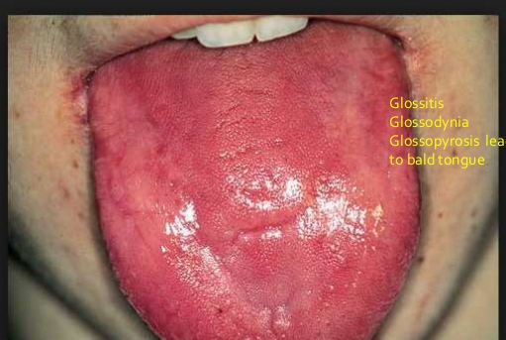
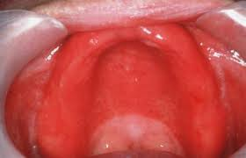
Continue
Tongue is often smooth (depapillated) and painful
Mucocutaneous candida infections are common, particularly of the erythematous form
Due to the lack of lubricating saliva, traumatic or frictional injury is increased.

Slide 9
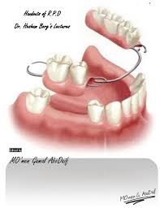
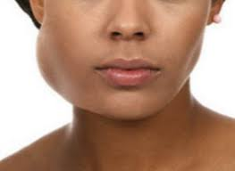
Continue
Removable prostheses are less well tolerated due to a reduction in retention usually afforded by saliva.
Parotid gland enlargement can be
  unilateral or bilateral,
  acute or chronic,
  retrograde salivary gland infection due to stasis or may be secondary to inflammation but may also represent a lymphoma
  20- to 40-fold increased risk of lymphoma

Slide 10
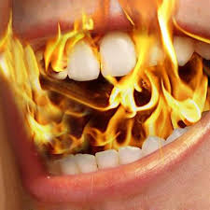
Continue
An oral burning sensation, stomatitis, or glossodynia is a common complaint in SS patients
  fungal infection
  SS-associated neuropathies
    hematinic deficiencies, allergies, oral lesions, or burning mouth syndrome must be ruled out.

Slide 11
Continue
The prevalence of peripheral nervous system involvement in SS has been estimated at 5%–20% and is most commonly reported as excruciating, burning pain of the extremities, or when the cranial nerves are involved, presents as a trigeminal neuropathy.

Slide 12
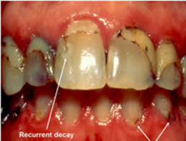
Continue
Changes in volume and composition of saliva may lead to an increased caries index, which may alert a clinician to suspect SS.
Patients with SS have a much lower pH and buffering capacity, which, coupled with the increased time for sugar clearance due to diminished salivary flow, leads to an increased rate of decay.

Slide 13
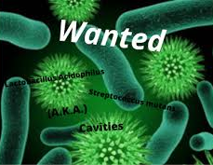
Continue
Patients with SS also have higher levels of cariogenic and acidophilic bacteria such as Lactobacillus acidophilus and Streptococcus mutans
caries are usually seen
  tooth-restoration interfaces
  root and facial surfaces and cusp tips

Slide 14
Serologic Signs
Hypergammaglobulinemia, (increased levels of a certain immunoglobulin in the blood serum)
Elevated sedimentation rate,
Decreased white blood cells
Hypocomplementemia

Slide 15

Diagnosis
American-European Consensus Group criteria involve six criteria
pSS having met four of the six categories

Slide 16
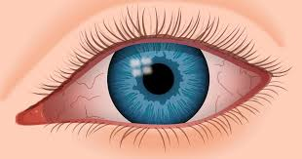
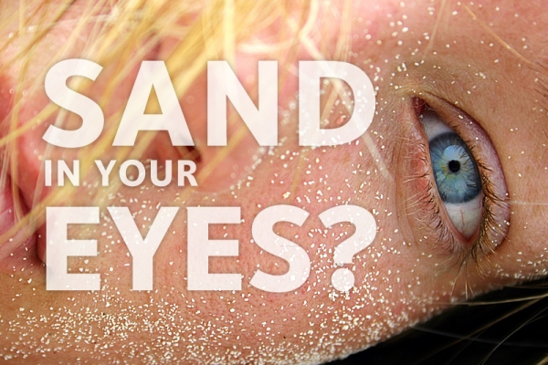
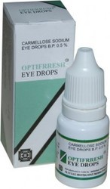
ocular symptoms,

Slide 17
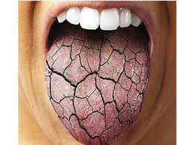
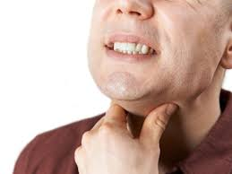
oral symptoms

Slide 18
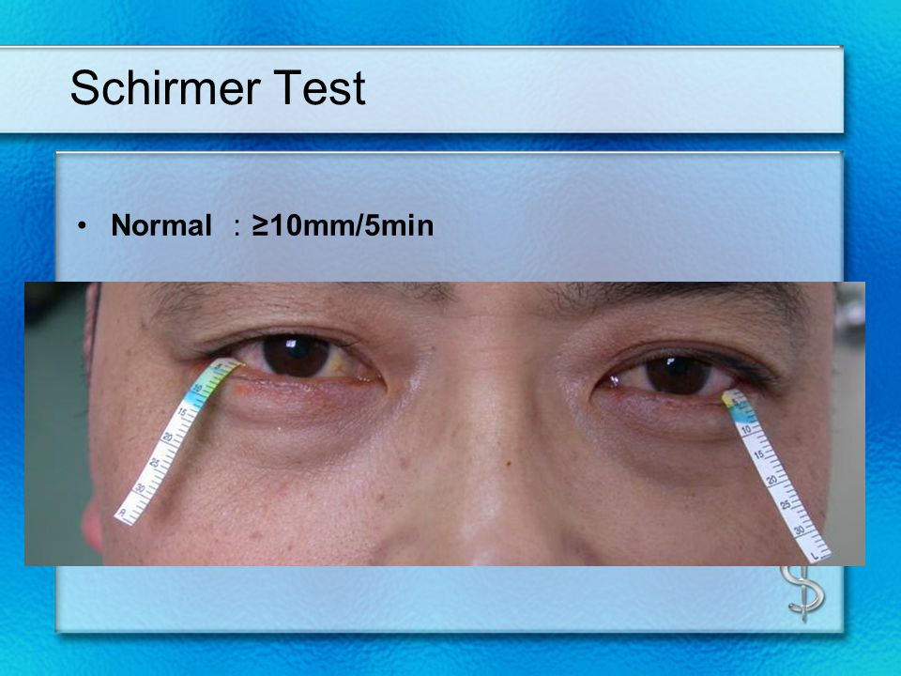
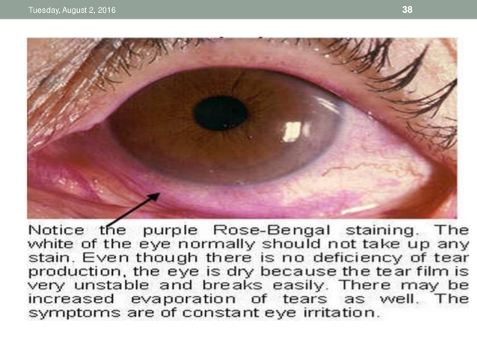
ocular signs

Slide 19
Minor Salivary Gland Biopsy
Is considered to be the best sole diagnostic criterion for the salivary component of SS

Slide 20
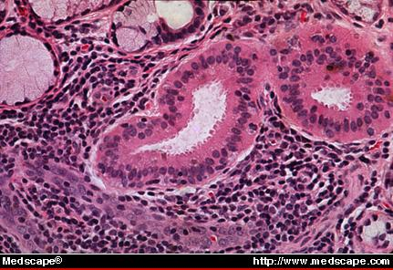
Histopathology
focal lymphocytic sialadenitis on a MSGB resulting in a Focus Score (FS) of ≥1 focus per 4 mm2

Slide 21
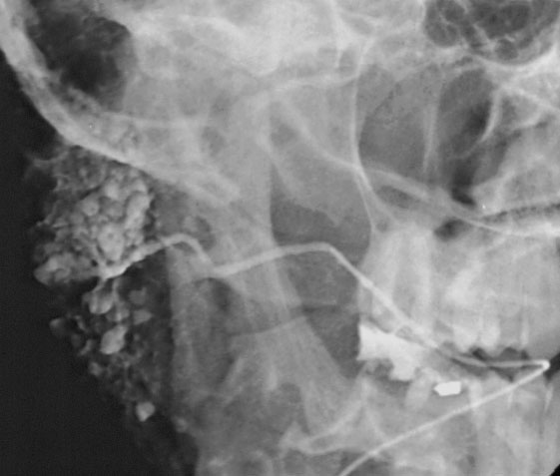
salivary signs
Scintigraphy
Sialogeraphy
WUSF(<0.1ml/min)
  1.5ml/15min

Slide 22
Autoantibodies
(anti-SSA [Ro] and anti-SSB[La]).

Slide 23
NOTICE
Critically, either a positive labial MSGB or the presence of at least one of the auto antibodies is required to establish a definitive case.
Alternatively, if three of the four objective criteria are satisfied (i.e., ocular signs, histopathology, salivary signs, and presence of autoantibodies), classification criteria are met

Slide 24
American College of Rheumatology
Patients with signs or symptoms suggestive of SS must have at least two of the following three objective features:
(1) a positive anti-SSA or anti-SSB or a positive RF with ANA ≥1:320;
(2) focal lymphocytic sialadenitis on a MSGB resulting in a Focus Score (FS) of ≥1 focus per 4 mm2;
(3) keratoconjunctivitis sicca with ocular staining score of 3 or greater.

Slide 25
Continue
Exclusion criteria
  include a history of head and neck radiation therapy, hepatitis C infection, AIDS, sarcoidosis, amyloidosis, graft-versus-host-disease, and IgG4-related disease.
  These criteria are considered more stringent and may therefore have an effect on the reported prevalence of the disease.
These classification criteria also eliminated the distinction between primary and secondary SS

Slide 26
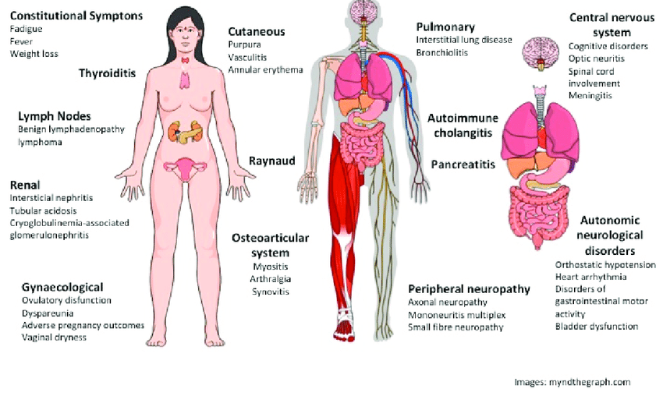
NOTICE
The presence of anti-SSA/Ro and anti-SSB/La antibodies is associated with a higher rate of extra glandular manifestations of SS and more active immunological status, when compared with seronegative SS cases.

Slide 27
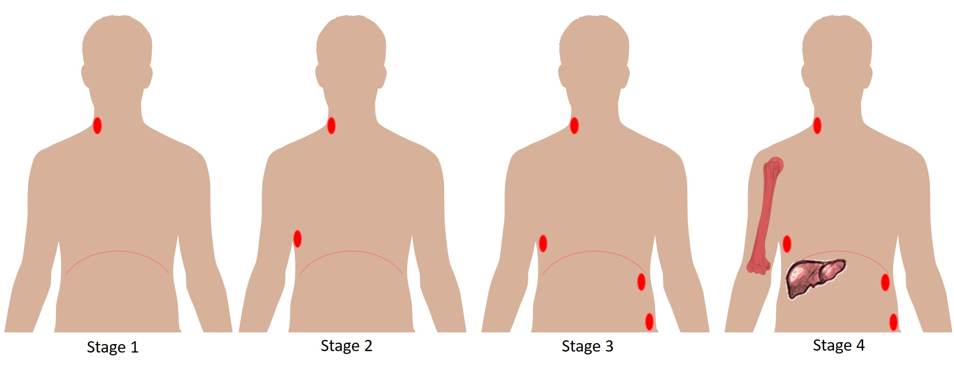
Notice
Anti-SSA/B-positive patients with SS are at a higher risk of developing lymphoma
Salivary gland lymphomas associated with SS are often indolent and progress very slowly necessitating close clinical monitoring of all patients.

Slide 28
NOTICE
Recent findings indicate that low vitamin D levels in patients with SS could be associated with severe complications such as lymphoma and peripheral neuropathy
In addition, since patients with primary SS are at an increased risk of NHL.

Slide 29
Treatment
Symptomatic treatment of glandular manifestations and on the use of disease-modifying drugs for systemic involvement.
We will focus primarily on the management of xerostomia and salivary gland hypofunction in SS patients.

Slide 30
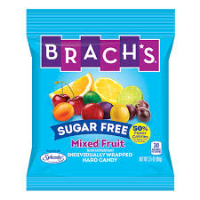
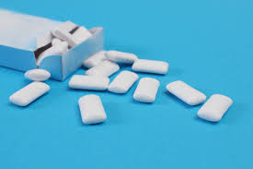
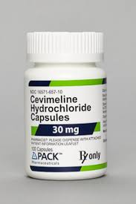
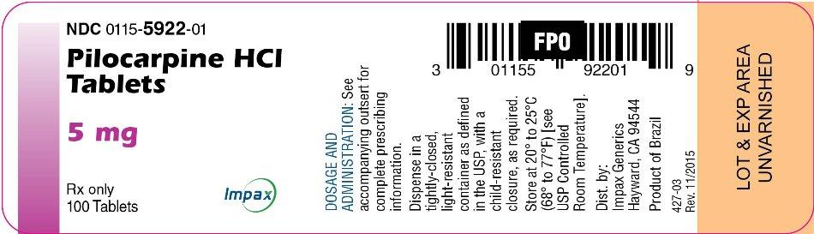
Secretagogues.
sugar-free gum or sugar-free candies
pilocarpine and cevimeline
  sweating, flushing, urinary urgency, nausea, and gastrointestinal discomfort.
  are frequent, they are rarely severe or serious

Slide 31

Salivary Substitutes
Saliva substitutes are thought to have a positive effect on nocturnal oral dryness without appreciable side effects.
However, clinical trial data have not shown a significant difference in efficacy between some salivary substitutes and a placebo
Preparations with mucin versus carboxymethylcellulose containing substitutes

Slide 32
Preventive Therapy
topical fluorides
  severity of the salivary dysfunction,
  the patient’s ability to perform oral care at home
  the rate of caries development

Slide 33
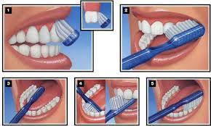
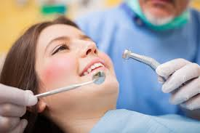
Continue
Essential that patients maintain meticulous oral hygiene
Dental visits (usually every 3–4 months)
Avoiding cariogenic, acidic and dehydrating foods, and beverages.

Slide 34
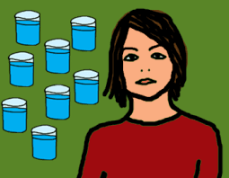
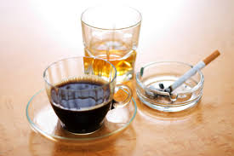
CONTINUE
8-10 glasses per day
Chronic use of alcohol and caffeine can increase oral dryness
Modified or avoided (crtain medication)
antifungal therapies

Slide 35
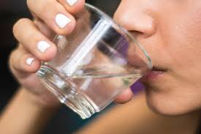
Symptomatic Treatment
Patients should be encouraged to sip water throughout the day
  moisten the oral cavity,
  hydrate the mucosa
  clear debris from the mouth

Slide 36

forming the food bolus easier, ease swallowing, and may improve taste perception.

Slide 37
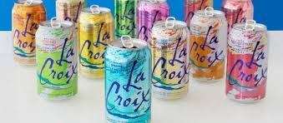
Use of sugar-free carbonated drinks is not recommended
Patients should be cautioned to avoid products containing alcohol, sugar, or strong flavorings that may irritate sensitive, dry mucosa

Slide 38
Moisturizing and lubricating products may provide additional comfort and help prevent friction-associated lesions
The frequent use of products containing aloe vera or vitamin E should be encouraged

Slide 39
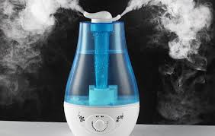
frequent awakening at night

Slide 40
Disease-Modifying Drugs
Although corticosteroids at high doses downregulate the immune inflammatory process within the salivary and lacrimal glands, data showing that they increase salivary and lacrimal flow rates are lacking.

Slide 41
Antimalarial Agents
Hydroxychloroquine has been reported to increase salivary flow rate and reduce some inflammatory indices such as ESR and C-reactive protein, and result in an improved immunologic profile involving RF, anti-SSA, and anti-SSB
  reduce the risk of lymphoma development

Slide 42
Immunosuppressant Agents.
azathioprine, methotrexate, mycophenolic acid, and leflunomide are

Slide 43
Hepatitis C Virus Infection
The HCV is an enveloped, single-stranded RNA virus of the family Flaviviridae.
hepatotropic, lymphotropic, and sialotropic
HCV has been associated with sialadenitis and sicca syndrome.
The reported occurrence of HCV-related sicca syndrome ranges from 4% to 57% of chronic HCV patients; the large range may reflect differences in diagnostic criteria

Slide 44
The mechanism by which HCV results in sicca syndrome has not been defined but studies show that HCV-related sicca syndrome is likely the product of a host immune-mediated mechanism rather than a direct viral effect since H

Slide 45
SUMMARY

Slide 46
References
Burket’s ORAL MEDICINE
12th edition

Slide 47
Thanks

